Slide 1
You had me at “Hello”: Emotional Intelligence and its Applications to Selection and Developing Nurse Anesthetists ©
American Association of Nurse Anesthetists
Assembly of School Faculty
Korrel Kanoy, PhD
kkanoy@developmentalassociates.com

Slide 2

An Overview of Today’s Session
Understand what emotional intelligence (EI) is
Describe how EI relates to success as a NA and in graduate school
Describe how to measure applicants’ El in the admissions process.
Answer your questions!
Notes:
BEGIN WITH STORY – Nurse who said to Justin – “see you on the flip side” ; brought extra chairs in,moved us to a larger room, palliative care brought a Duke t-shirt,

Slide 3
WHY EMOTIONAL INTELLIGENCE?

Slide 4
POLL: How important is IQ to your success?
HINT! IQ opens doors to certain careers, but it typically a poor predictor of success within a career.
On average, what percentage of workplace success within a career is predicted by IQ?
1%
6%
20%
50%
Notes:
1%
6%
20%
50%

Slide 5
How important is EQ (EI) to your career success?
On average, how much success within a career is due to your EQ or emotional quotient?
a. 5%
b. 10%
c. 20%
d. 30%
Notes:
Have participants GUESS how much of workplace success is due to IQ v. EI.
IQ accounts for .01 to .20 of career success
(IQ determines what careers are open to us – astronaut v. ditch digger – but accounts for much less in terms of success within a career.)

Slide 6
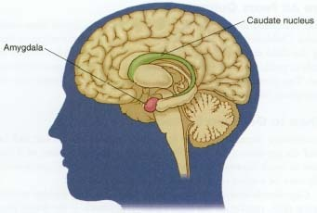
EI And The Brain
Emotions begin in the limbic area but need to be processed in the frontal lobe for intelligent responses or else hijacking occurs, which limits responses to
Flee
Freeze
Fight
Nurture
1.6
Notes:
Amygdala: a major structure leading to patterns of physiological change which pause when emotion occurs. The connection is thalamus to cortex to amygdala. Thus, we may have an emotional reaction/response before we’re aware what’s going on. View this chart first and then rapidly move to the next, which shows the amygdala.
The following is a good reference for the learner...
Diamond, M.C., Scheibel, A.B., and Elson, L.M. (1985). The human brain coloring book. New York: Barnes & Noble Books, a Division of Harper & Row, Publishers. 1-2; 1-3.

Slide 7
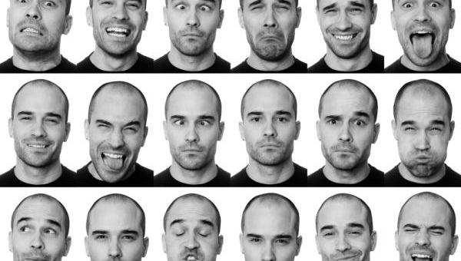
How many emotions occur in one day?
Notes:
A. 10
B. 35
C. 100
D. Over 300
How many emotions does a typical person experience daily?

Slide 8

Do emotions ever affect your decisions or actions? NEED TO AVOID EMOTIONAL HIJACKING!
Notes:
EXERCISE 2: MY BEST and WORST BOSS
Which part of the model accounts for the reason most people leave a job?
A. STRESS TOLERANCE = job is too stressful
B. INTERPERSONAL RELATIONSHIPS = poor relationships with boss
C. DECISION MAKING = poor decisions by leaders drive employees away

Slide 9
When asked what El is, the best answer is … A question!
Do you want to
Communicate effectively with others?
Understand yourself, what motivates you, what hinders you, why you are (or not) confident etc.?
Work effectively with others?
Make excellent decisions?
Manage your stress well and AVOID getting hijacked by others’ actions?
IF the answer is yes, you want high emotional intelligence!

Slide 10
NURSING EFFECTIVENESS AND EMOTIONAL INTELLIGENCE

Slide 11
El v. Academic Predictors of NA Grad Success
  Typical admission requirements (grades, experience) did not predict progression through NA program. Reese (2002)
  Graduate success correlated with higher El skills Beauvais et al., 2013
  Comparison of 1st semester to last semester students revealed no difference in EI (Collins & Andrejco, 2015)
  Higher El predicted success on the NCE but NOT GPA in the NA program; El not correlated with Science GPA, GRE or years of nursing experience Collins (2013)
  THUS, academic and El are separate predictors!

Slide 12
El & Anesthesia Student Success
  COLLINS (2013)
  Attrition creates problems for students (debt, lost opportunity), institutions (lost revenue, problems at the clinical site) and hospitals (shortage of NAs)
  Collins found a consistent EI type in grad NA students – high in reading others’ emotions but low in managing their own emotions, thus unable to direct emotions for long-term benefit.

Slide 13
El Predicts Nursing Success
Higher EI minimizes the negative consequences of stress in nurses (Landa et al., 2008; Montes-Berges & Augusto, 2007; Vitello-Cicciu, 2009)
Por and colleagues (2011) found El was negatively related to stress and positively related to
  well-being
  problem-focused coping
  nursing competency
Nursing performance (6-D scale) positively related to EI (Beauvais et al., 2010)

Slide 14
Codier (2010)
Nurses wrote stories about encounters with patients (not given instructions about including El)
Measured nurses’
  Professionalism
  Performance
  Nursing “Intuition”
Higher professionalism positively correlated with emotional self-awareness, empathy, social responsibility, interpersonal relationships, problem solving and stress tolerance

Slide 15
Codier (2010) continued
Higher performance positively correlated with empathy, social responsibility, interpersonal relationships, problem solving and stress tolerance
Presence of intuition in stories rated yes-no by nursing experts; Intuition positively correlated with empathy, interpersonal relationships, and emotional self-awareness
Intuition also correlated (p <.001) with performance but not professionalism

Slide 16
Collins
“ The results of this study have practical implications for SRNAs and NA educators …with possible future use of EI as admission criteria or inclusion of El training in the NA curriculum.” ( p. 470)

Slide 17
Health Care Success and EI
Talarico et al. (2012) – anesthesiology residents showed higher performance with higher El
Beauvais et al (2010) – El correlated with measures of better nursing performance
During clinical placements (undergrads), higher El is associated with (Lewis, Neville & Ashkanasy, 2017)
  Buffering of stress
  Reduced anxiety about end-of-life care
  Better communication
  Better performance

Slide 18
El and Retention and Job Satisfaction
Michelangelo (2015) – nurses with higher El performed better and had higher job satisfaction and retention
Hong and Lee (2016) – higher El is associated with
  Lower emotional labor
  Less job stress
  Less turnover intention

Slide 19
Need to Include EI in NA Selection
Cadman & Brewer (2001) advocated using EI to SELECT NA students because of importance of EI to academic & nursing success
Freshwater & Stickle (2004); developed a model of transformative learning that included El
El does NOT increase during the NA graduate program; comparison of 1st semester to last semester students revealed no difference (Collins & Andrejco, 2015); THUS, need to select for El or teach it!

Slide 20
INTRODUCTION TO EMOTIONAL INTELLIGENCE

Slide 21
3 Major Models of Emotional Intelligence
EQi 2.0 - Baron & MultiHealth Systems
MSCEIT – Mayer, Salovey and Caruso
ESCI – Goleman
ALL models measure
Self—awareness of emotions and triggers
Self-management (stress, decision making, etc.)
Other awareness (their emotions, empathy, etc.)
Management of relationships (working effectively with others)

Slide 22
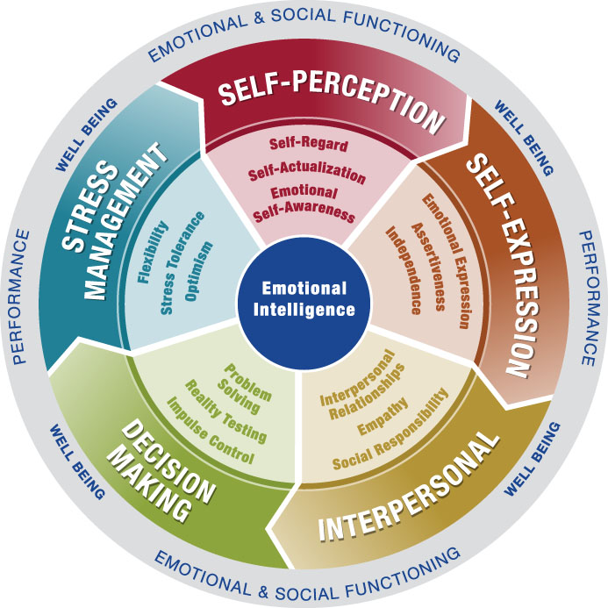
The EQ-i^{2.0} Model
Copyright (C) 2011 Multi-Health Systems Inc. All rights reserved. Based on the Bar-On EQ-i model by Reuven Bar-On, copyright 1997.

Slide 23
SELF AWARENESS

Slide 24
Emotional Self-awareness (ESA)
Recognize emotions as they happen
Understand what triggers different emotions in you – what are your HOT BUTTONS?
Impact of your emotions on others
If LOW, NA
Blow up, lose control easily
Cannot process their reactions effectively
May respond to everything with anger, not recognize that they are anxious or sad

Slide 25
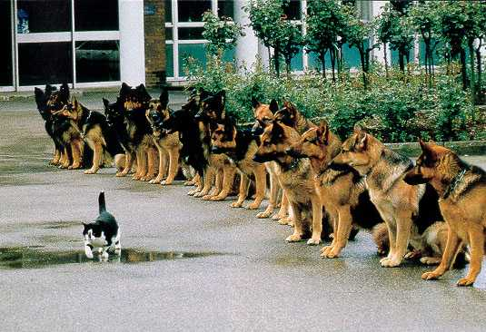
Self-regard
Understand your strengths and limitations
Accept yourself despite limitations
Confidence
If LOW, NA: blame others, don’t take feedback, lack confidence in challenging situations
Notes:
EXERCISE 4: BUILDING SELF-REGARD

Slide 26

Self-actualization
Goal oriented
Receives satisfaction from work
Strives for self-improvement
If Low, NA: just want degree but not learning, does not stretch self or take advantage of opportunities to learn
Notes:
EXERCISE 5: SELF ACTUALIZATION
Here was the chance to not only employ their skills but to save the whole town

Slide 27
SELF PERCEPTION (COMMUNICATION)

Slide 28

Emotional Expression (EE)
Express feelings effectively
verbally & non-verbally
Open, appropriate,
and congruent in emotions
If LOW, NA
Miss opportunities to moti-
vate patients
May have outbursts
Inappropriate non-verbal (eye roll)

Slide 29
Independence
HELP ME!
v.
I CAN DO IT
MYSELF!
Self-directed
Free of emotional dependency
Avoid need for reassurance
If LOW, NA
Over-relies on faculty for help, even on tasks should have mastered
Needs reassurance often
Takes up lots of faculty time!
Notes:
SMALL GROUP DISCUSSION: WHAT PARTS OF A CHIEF JUDGE ROLE REQUIRE THE MOST INDEPENDENCE?

Slide 30
Assertiveness
Patch Adams - I Want to Leave
Express thoughts, feelings and opinions appropriately
Take up for self in non-offensive ways
Courage to confront appropriately – 84% of mistakes in medical situations are “overlooked” or not reported by others (Patterson, Grenny, McMillan, & Switzer, 2012)
If LOW, NA: passive when should offer an opinion, taken advantage of, lets patients or others dominate

Slide 31
INTERPERSONAL RELATIONSHIPS

Slide 32


Interpersonal Relationships
Degree to which you can have mutual and enjoyable relationships with others, be appropriately vulnerable, share feelings
Build trust
If LOW, NA
Disconnected
Often a poor team member
Cannot motivate others to follow
Notes:
SMALL GROUP DISCUSSION: AS A SMALL GROUP, COME UP WITH WAYS TO BUILD RELATIONSHIPS WITH YOUR CLERK, MAGISTRATE, and JUDGES.

Slide 33

Empathy
Show interest in and concern for others
Aware & understand other’s thoughts & perspectives
Don Berwick: hospital CEOs
If LOW, NA: does not listen, cannot connect with patients’ fears, etc.; perceived as “cold” & ineffective
https://www.youtube.com/watch?v=1RXiN33krqxbs&list=RD1RXiNkrqxbs&t=4 (Penny’s stuck key)

Slide 34

Social Responsibility
Teamwork and collaboration
Doing your fair share
Sense of responsibility for others on the team
If LOW, NA:
try to get out of work
leave tasks for others he/she should do
“me first”

Slide 35
DECISION MAKING

Slide 36
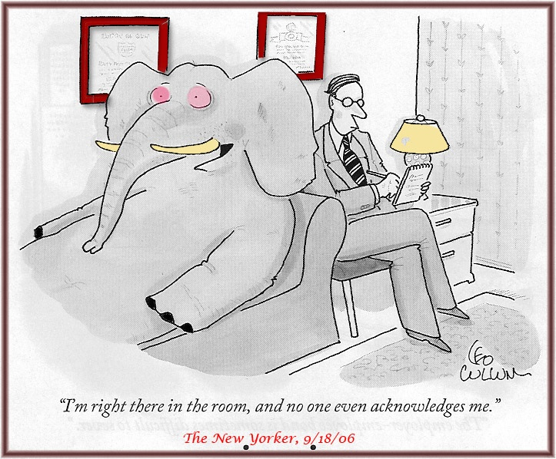
Problem Solving
Ability to recognize, define, and systematically address problems in situations where emotions are involved
Desire to confront rather than avoid problems
If LOW, NA: “freeze, flee, or fight” instead of problem solving; avoid conflicts
Notes:
EXERCISE 7: PROBLEM SOLVING A RECURRING ISSUE

Slide 37
Reality Testing
Accurately read facts & the situation, neither over- nor under-react
Curious & examining rather than passive
Objective, not biased
If LOW, NA: ignore facts they don’t like, do not collect necessary info
Notes:
EXERCISE 8: REALITY TESTING

Slide 38

Impulse Control
Resist or delay drives or temptations
Not over-react
Remain patient
Marshmallow
If LOW, NA: may be impatient with patients, put leisure before necessary work, say and do things that create trouble for them, don’t think before acting
Notes:
http://www.youtube.com/watch?v=rNseShYxCVc (Catch Me If You Can – hotel scene – Removed by YouTube
EXERCISE 9: GREATEST IMPULSE CONTROL CHALLENGES

Slide 39
STRESS MANAGEMENT

Slide 40

Stress Tolerance
Ability to withstand adverse events and conditions without “falling apart” or losing focus
If LOW, NA: cannot concentrate, flustered, cannot complete assignments or procedures due to cognitive disorganization
Notes:
EXERCISE 10: MANAGING YOUR STRESS

Slide 41

Flexibility
Ability to adjust emotions, thoughts and behaviors to the situation
Accept or initiate change when needed
If LOW, NA: complain about changes in clinical placements, prefer status quo over new techniques, resist unexpected changes

Slide 42

Optimism
Positive attitude
Persevere in the face of adversity
IF LOW, NA:
Expect the worst
Frame situations negatively
Lower others’ morale
Notes:
http://www.youtube.com/watch?v=gHXKitKAT1E Pursuit of Happyness Internship Interview
EXERCISE: REMAINING OPTIMISTIC

Slide 43
SELECTING FOR EMOTIONAL INTELLIGENCE IN THE GRADUATE ADMISSIONS PROCESS

Slide 44

Current Admission Methods Not Sufficient
Unstructured or structured interviews yield a 50% success rate of picking the best applicant
Do you want to roll the dice at a
50% success rate with the
consequences of …
Clinical problems?
Greater faculty involvement with problems?
Less effective graduates of your program?

Slide 45
SELECTING STUDENTS: OPTIONS FOR INCLUDING Emotional Intelligence Screening!
Emotional Intelligence Interview
Emotional Intelligence Written Application Question
Emotional Intelligence Role Play (Simulation)
ALL options include
Interview with your faculty to determine what El skills are most predictive of success in your program
1-7 scoring rubrics to ensure reliability & validity
Checklist of El skills present or absent
Training for faculty to use the system

Slide 46

Emotional Intelligence Interview for NA Applicants
4-10 questions El questions developed
1-7 Behaviorally Anchored Rating Scales (BARS)
used to judge overall effectiveness of answers
EI behaviors relevant to the question (see
examples below) are noted as present or not
  Reality testing – collected relevant information; considered facts and information; made objective decision that fit facts
  Self-regard – accepted feedback without defensiveness; acknowledged own mistakes

Slide 47
Sample El Question & El Scales
Describe a work situation when you were working with others and the situation did not go well. Describe the situation, what caused it to not go well, and what you did when you recognized it wasn’t going well. (problem solving, social responsibility, flexibility, empathy, self-regard, stress tolerance)
Note, If the student is applying at the completion of undergraduate studies, change the question to “Describe a team project in your undergraduate studies that was important to you and did not go well. Describe the situation, what caused it to not go well, and what you did when you recognized it wasn’t going well.

Slide 48
Sample Written Question: Use on Application or Interview Day
EXAMPLE: Tell us about a time you got feedback from someone else that you disagreed with. What was the situation, what was the feedback and what did you do? (reality testing, self-regard, self-actualization, assertiveness, empathy)
Any El question developed for the interview can be converted to a written question

Slide 49
Role Play (Simulation) for Assessing EI
Example: A current graduate student or faculty member will act as the patient. The applicant is given the following information: Ms. Adams is awaiting heart surgery with her husband and daughter. They are anxious about the surgery and about the anesthesia. You are about to meet with them. (NOTE, programs may supply information about what drugs will be used if they want to do so.)
The “patient” is given specific wording to use with each applicant that shows fear and mild distrust of the anesthetist. Depending on how the applicant responds, the patient is instructed to 1) elevate her concerns and become more resistant, 2) continue at the initial level of concern and remain skeptical, or 3) de-escalate her concerns and become cooperative.

Slide 50
INFUSING El INTO CURRICULA, PROGRAMS
Professional Development Seminars or Workshops
  Review case studies that required El skills
  Have students complete a reliable and valid emotional intelligence assessment and create a development plan
  EI units could be added to relevant courses or required activities such as simulations, discussion boards
Remediation – if a student is performing poorly, part of the action plan for improvement should address El skills
Assessment of Clinical Effectiveness – a checklist of El skills is provided to preceptors to give feedback to the students (Korrel has developed this list!)

Slide 51
Want to learn more?
Contact Korrel Kanoy at 919-452-7130; kkanoy@developmentalassociates.com
QUESTIONS?
All references for citations in this PowerPoint are listed in the reference handout.

